Slide 1

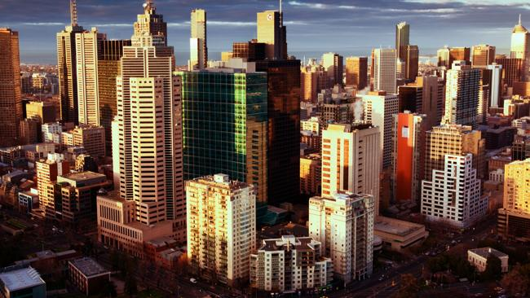

What makes a place liveable?
14 July, 2017
L/O: Students will examine a variety of locations and decide what makes a place liveable.

Slide 2

Starter:
Monocle Magazine conducts a Quality of Life survey annually. The purpose of this survey is to find out what makes a city ‘a good place to live in’.
10 of the top 25 cities are listed here. Working with a partner, decide which cities are the top 3 most liveable cities in the world. (1 being the best).
Zurich
Melbourne
Tokyo
Sydney
Copenhagen
Helsinki
Berlin
Madrid
Dubai
Honolulu
Extension: Justify your answers! What do you think makes your #1 most liveable city the best?

Slide 3

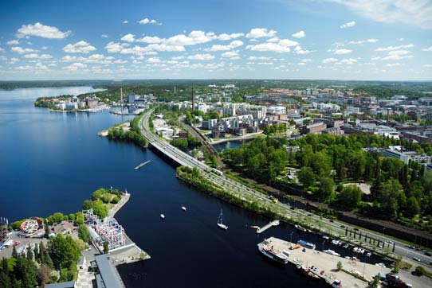


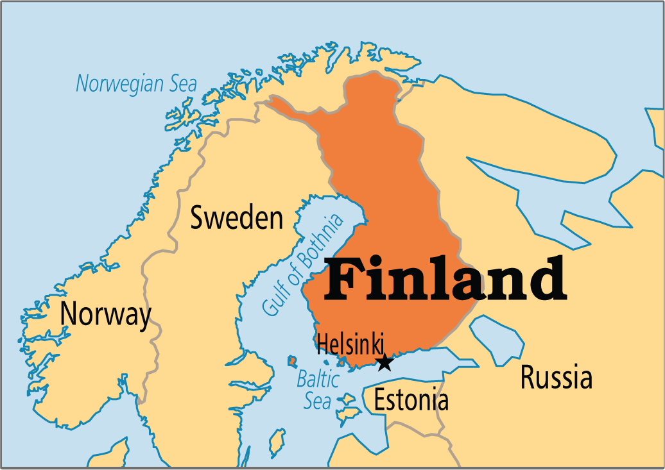
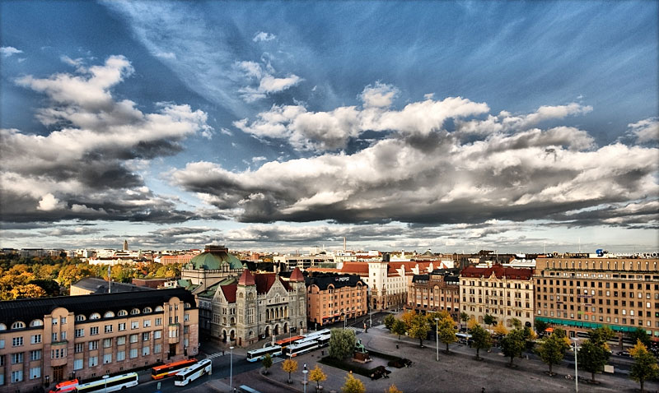
Finland

Slide 4
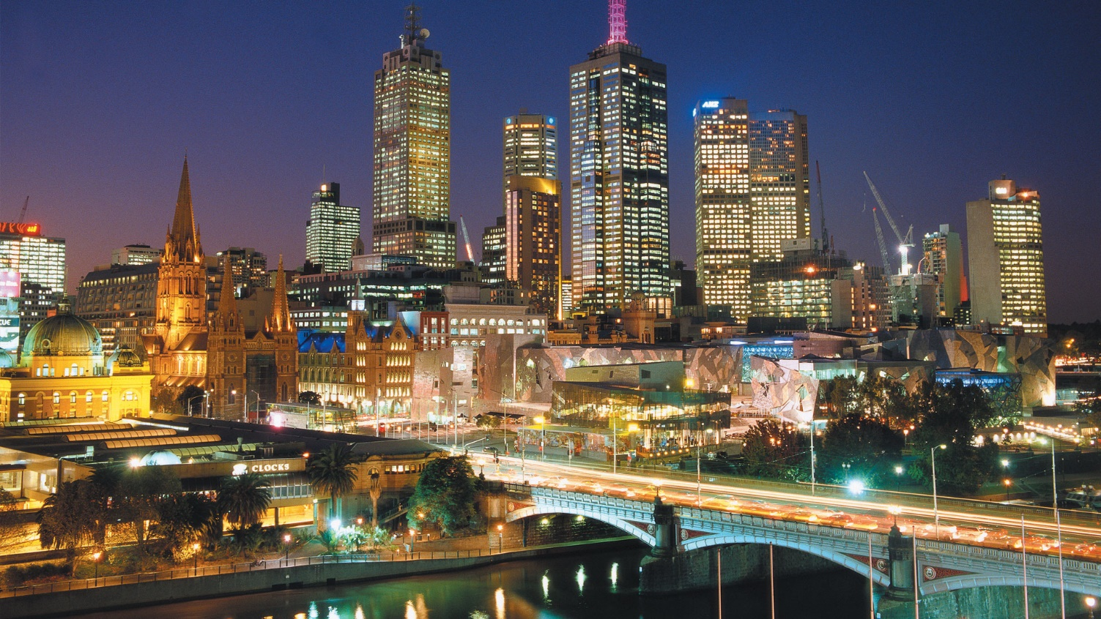

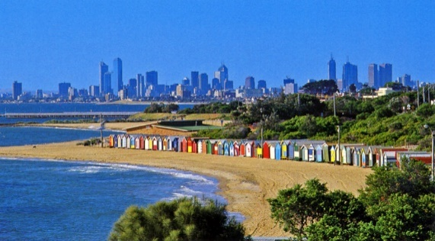
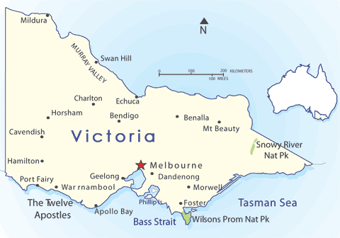
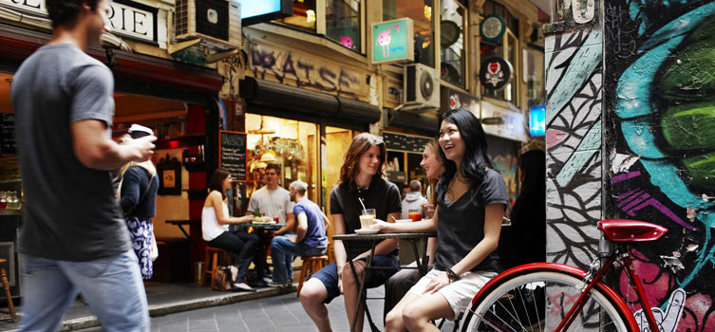
Australia

Slide 5
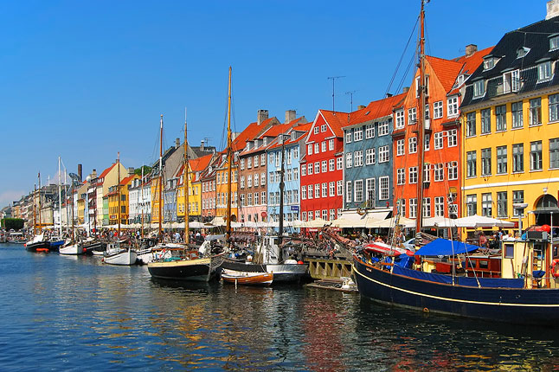

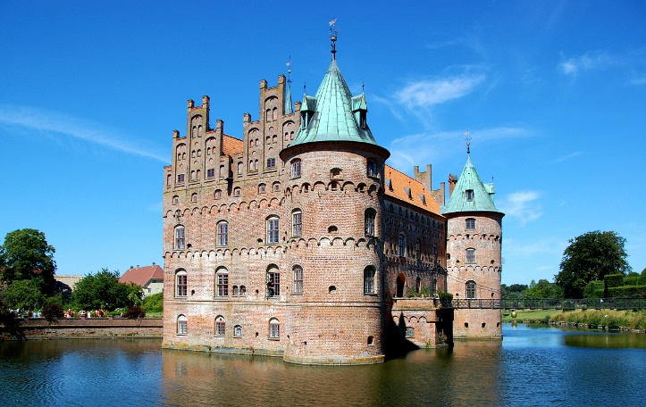
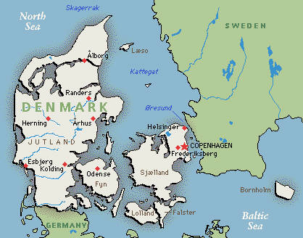
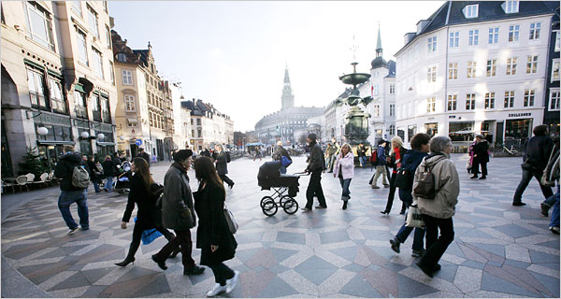
Denmark

Slide 6

Glossary:
Liveability:
Quality of life (QOL):
Liveability: The features of a place that improve the quality of life. (Environment, services, infrastructure, transport etc)
Quality of life: The condition of a human life. (Excellent, good or poor) Residing in a liveable area improves QOL.

Slide 7



Plenary:
Concept Map:
Work in groups of 4 to complete an A3 concept map on ‘what makes a place liveable?’ You should aim to make your chart as detailed as possible and contribute equally as a group.
Hints:
Think about what you like about your city, and things you’ve enjoyed at other places you’ve visited.

